Slide 1
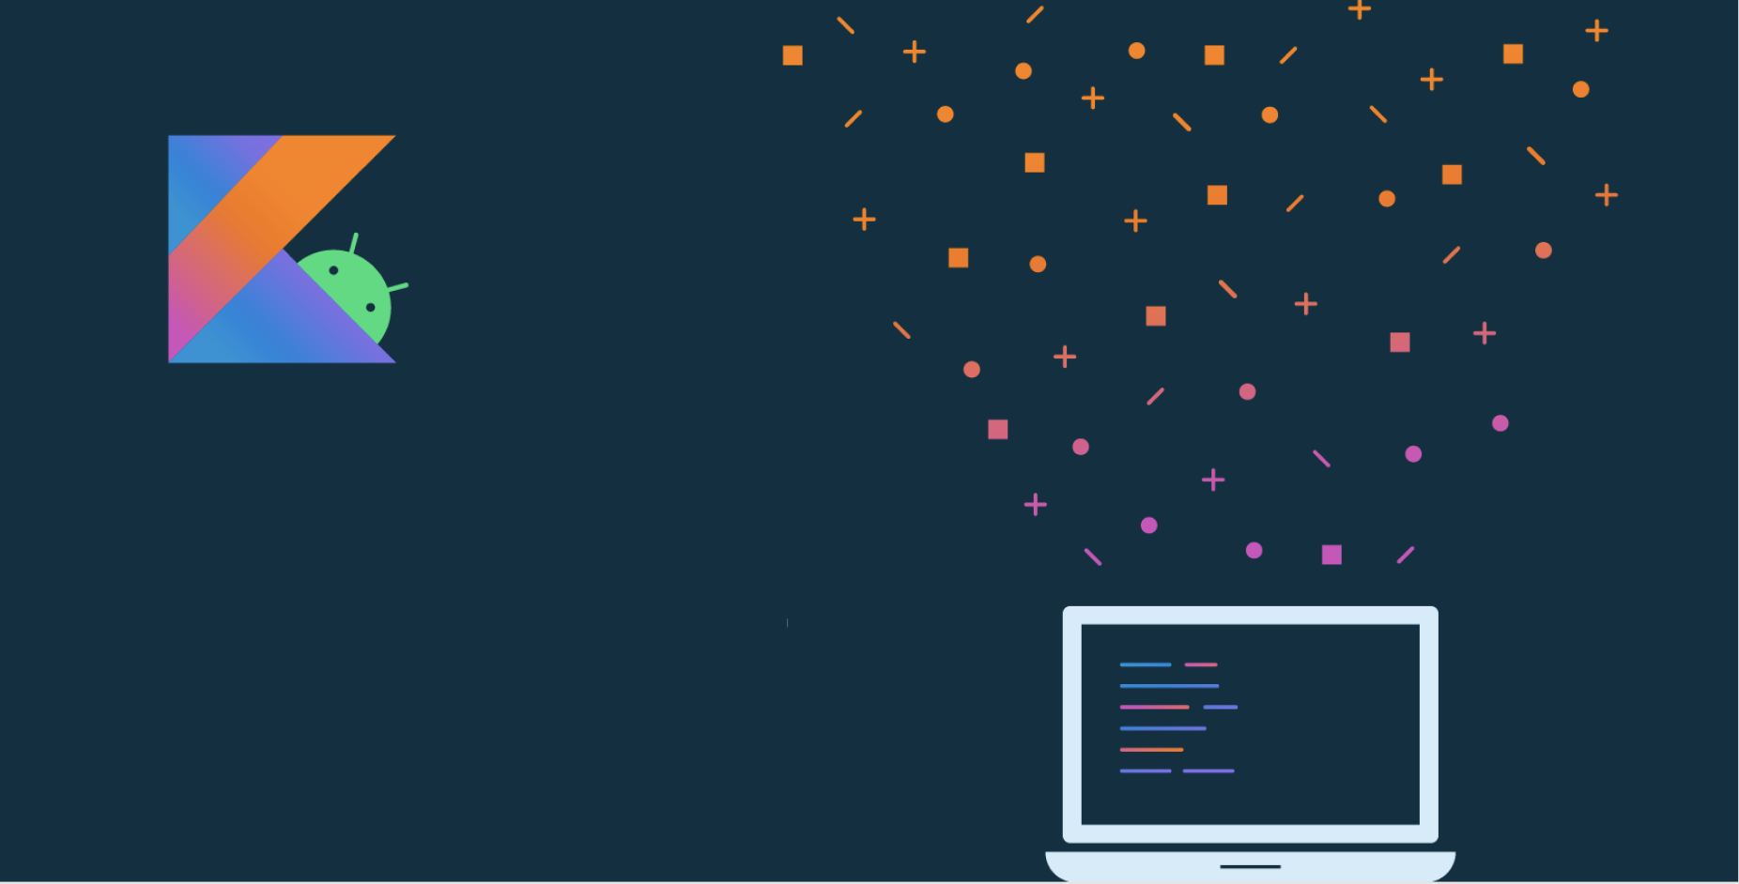
Lección 4:
Crea tu primer aplicación Android

Slide 2
Acerca de
Lección 4: Cree su primera aplicación para Android
Tu primera App
Anatomía de una aplicación de Android
Diseños y recursos en Android
Actividades
Haz que una aplicación sea interactiva
Gradle: creación de una aplicación de Android
Accesibilidad
Resumen

Slide 3
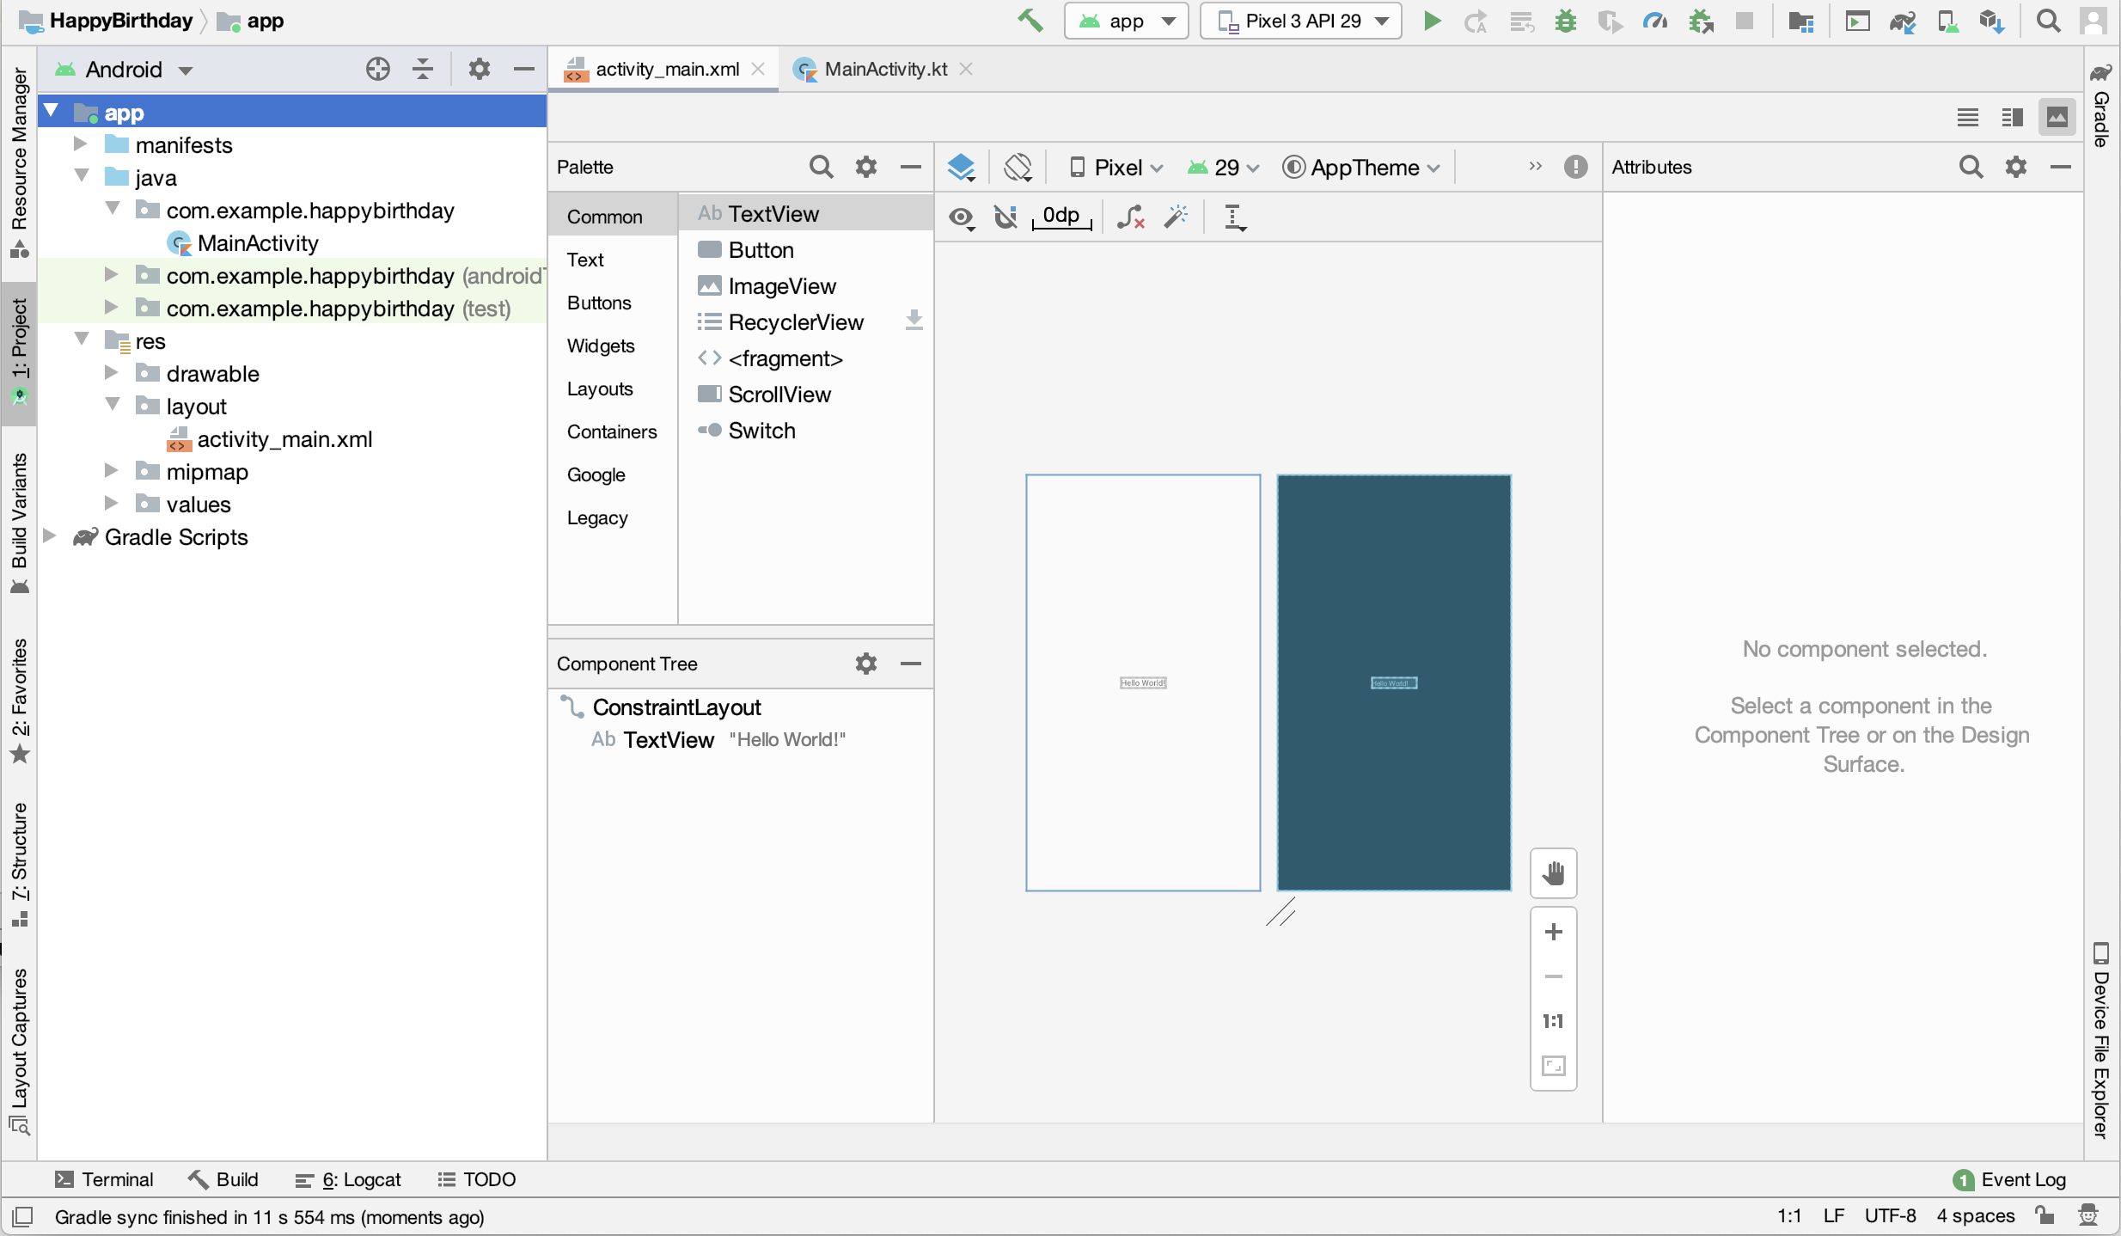
Android Studio
IDE oficial para crear aplicaciones de Android
Notes:
This is Android Studio - the official integrated development environment (IDE) for Android development. It’s built on IntelliJ IDEA and it has lots of features to make it faster and easier to develop Android apps.
Installation instructions and a formal walkthrough will be in the labs. This lecture will focus more on high-level concepts.
Resource:
Download Android Studio and SDK tools

Slide 4
Tu primer aplicación

Slide 5
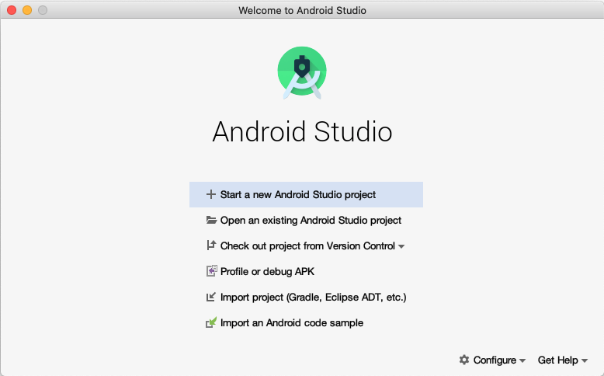
Open Android Studio
Notes:
When you open Android Studio, the Welcome to Android Studio dialog displays.

Slide 6
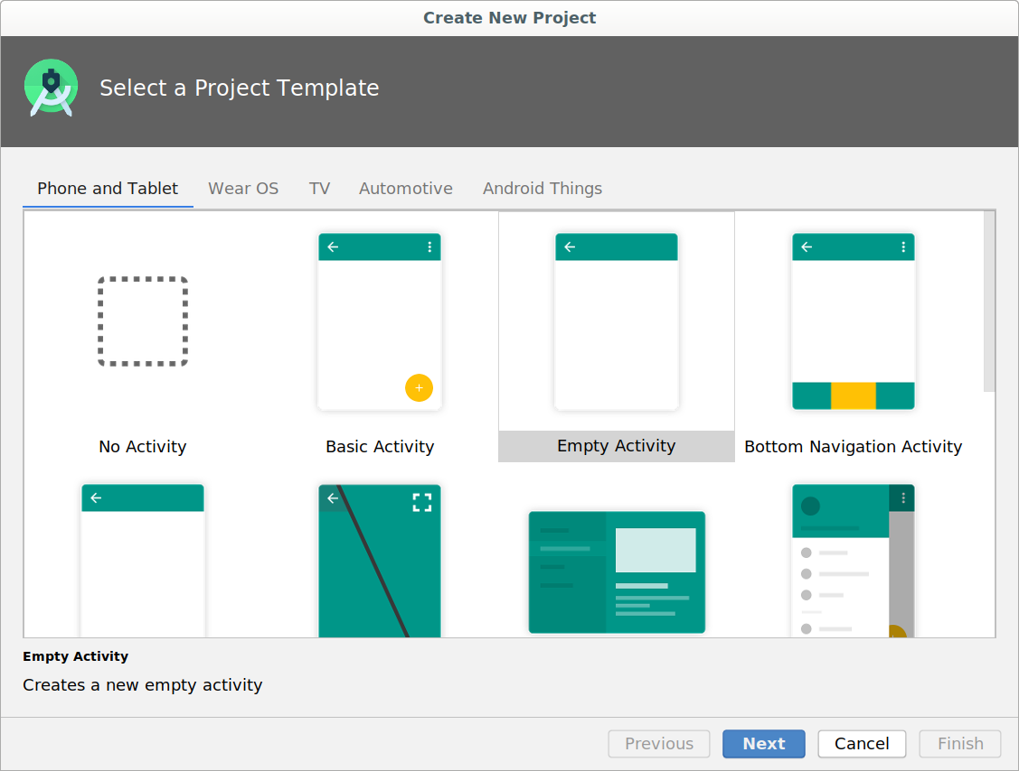
Crear un nuevo proyecto
Notes:
There are lots of templates here that contain starter projects to help you build different kinds of apps. We'll select the Empty Activity template to give us a simple working app.

Slide 7
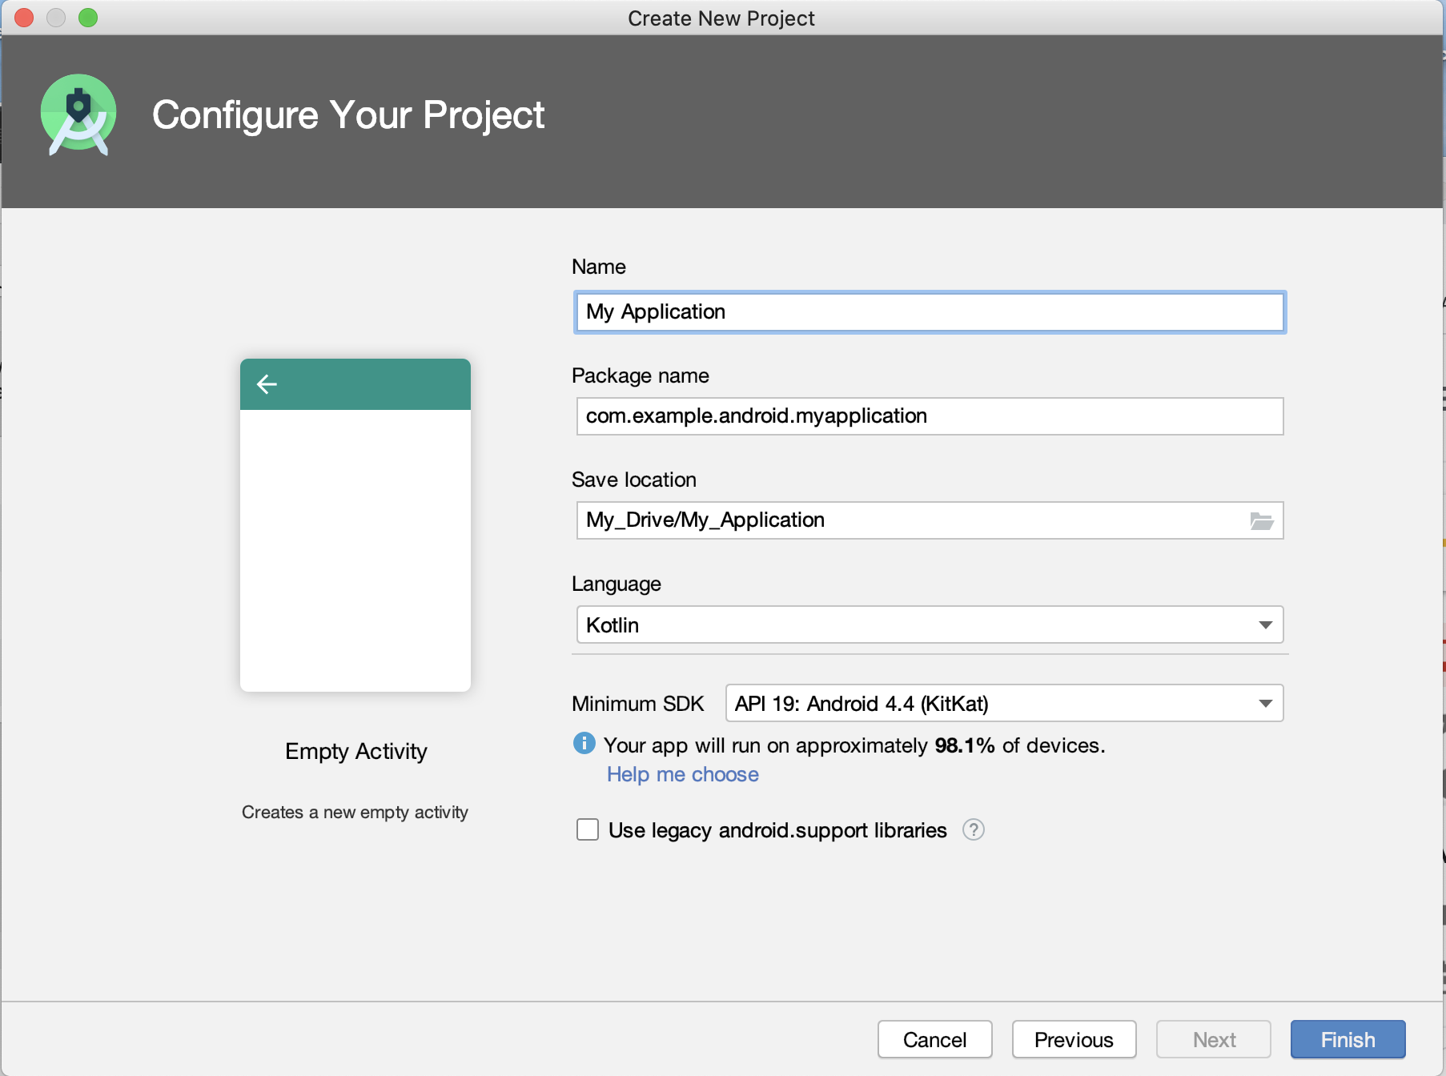
Ingresar detalles de tu proyecto
Notes:
Name - Enter a name for your application.
Package name - A globally unique name that represents your app, similar to a web address. This often is the company web domain (defaults to android.example.com) plus the name of the app. If you are not planning to publish your app, you can use the default. You can change this later, but it's extra work. This will also be the default Java and Kotlin package for your source code.
Save location - This is where your app is stored on your computer.
Language - Kotlin and the Java programming language are both supported. For this lesson, select Kotlin. You can mix Kotlin and Java in different source files in the same project as needed.
Minimum SDK - For this project, make sure the Minimum SDK is API 19: Android 4.4 (KitKat). (Click Help me choose, to see information about API levels.)

Slide 8
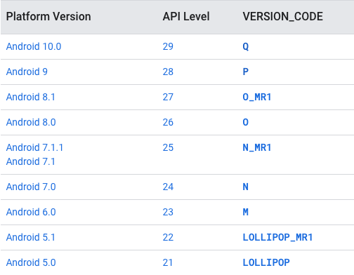
Android releases y API levels
Notes:
Android devices may be running different versions of Android. Each Android release has a:
Platform Version
API level (for developers)
Version Code —- letters with sweet treats - still occasionally used when talking about Android
As new versions of Android are released, developers need to stay up-to-date with the latest best practices to ensure their apps deliver the best experience on as many devices as possible. To find out about the latest versions, their API levels, and the devices they support, check What is API Level?

Slide 9
Elija niveles de API para su aplicación
SDK mínimo: el dispositivo necesita al menos este nivel de API para instalarse
Target SDK: versión de API y versión de Android más alta probada
Compilar SDK: versión de la biblioteca del sistema operativo Android compilada con
minSdkVersion <= targetSdkVersion <= compileSdkVersion
El nivel de API identifica la versión de la API de marco del SDK de Android.
Notes:
When you create an Android project, you'll need to define three API levels:
The minimum required for a user to install your app
The user version you are targeting
The version to use to compile your app
Note that the minimum SDK version has to be less than or equal to the target SDK version, which has to be less than or equal to the compile SDK version.
As new releases of Android come out, it is good practice to compile and test your app against the latest version of the platform, and increment the compileSdk and targetSdk levels.
Resources:
What is API Level?
Picking your compileSdkVersion, minSdkVersion, and targetSdkVersion

Slide 10
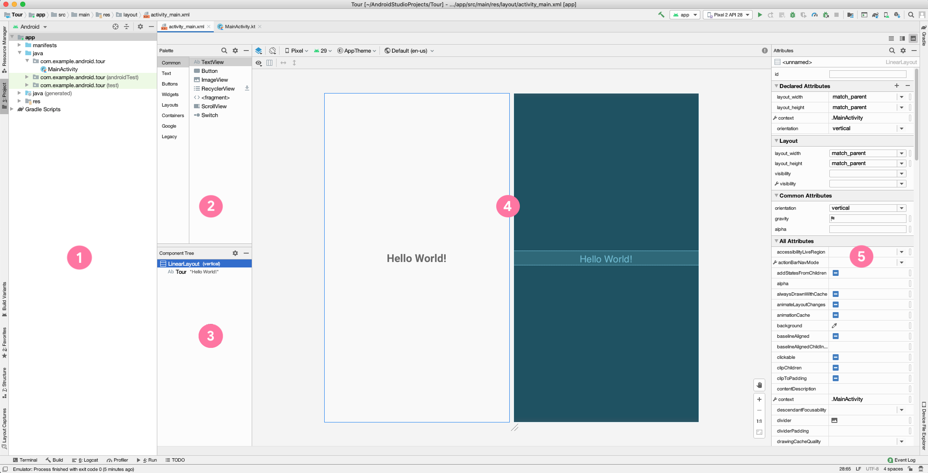
Recorrido por Android Studio
Notes:
In this view of Android Studio, you can see the Project window and the Layout Editor. The Layout Editor includes a Palette, a Component Tree, a Design Editor, and an Attributes window.
Project window shows the files and folders for your project.
Palette shows the components and layouts that you can drag into your project, such as TextViews, ImageViews, and Buttons.
Component Tree shows the view hierarchy for your layout. Click a component or layout to show it in the Design Editor.
Design Editor displays a Design view and a Blueprint view to give you a visual representation of your layout.
Attributes window contains a list of properties you can set for your component.
Resource:
Meet Android Studio

Slide 11
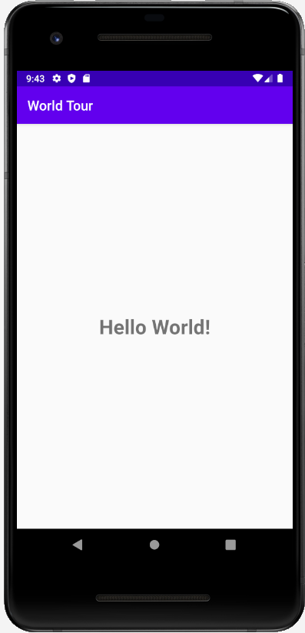
Ejecute su aplicación
Dispositivo Android (teléfono, tableta)
Emulador en tu computadora

Slide 12
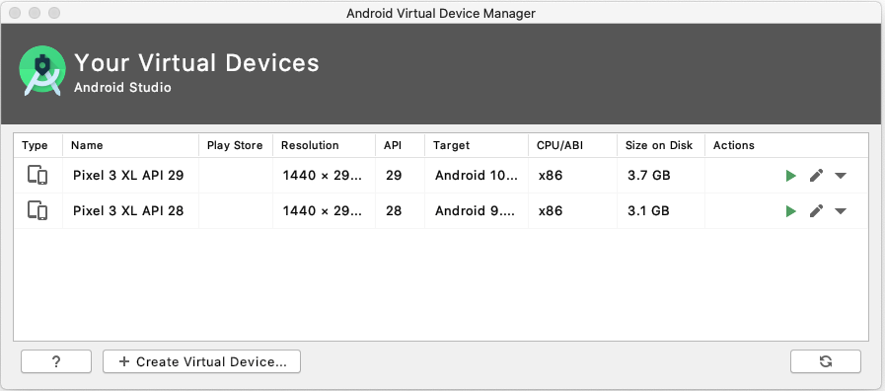
Android Virtual Device (AVD) Manager
Notes:
In addition to running your app on a physical device, you can use the emulator to emulate many different Android form factors with the help of the Android Virtual Device (AVD) Manager.
Note that you’ll need to download each system image that you want to emulate, since there are many possible options.

Slide 13
Anatomía de una aplicación de Android
proyecto

Slide 14
Anatomía de un proyecto de aplicación básico
Actividades
Recursos (archivos de diseño, imágenes, archivos de audio, temas y colores)
Archivos Gradle
Notes:
In a basic app project, the main parts to know about are the Activity, the app’s resources, and the gradle files. We’ll cover each topic in more depth in this lesson, but briefly:
An Activity handles user input and creates a window on the screen to display your user interface.
Resources are additional files that your code uses, such as layout files, images, audio files, themes, colors, and more.
Gradle files are scripts that control how your app is built, so that it can be installed on a device.

Slide 15
Estructura del proyecto de la aplicación de Android
MyApplication
├── app
│ ├── libs
│ └── src
│ ├── androidTest
│ ├── main
│ │ ├── java
│ │ ├── res
│ │ └── AndroidManifest.xml
│ └── test
├── build.gradle
└── gradlew
Notes:
When you create your first app from a project template, Android Studio generates a project structure similar to this.
Here’s what each file or directory does:
app - stores source code, tests, and resources for your app
libs - stores local libraries your app depends on
androidTest - test code that’s specific to Android
main - Java and Kotlin app files
test - local unit tests that will execute on your computer
AndroidManifest.xml - declares essential information for your app
build.gradle - controls how your application builds, tests, and deploys itself
gradlew - an executable to run gradle, even if it is not already installed

Slide 16
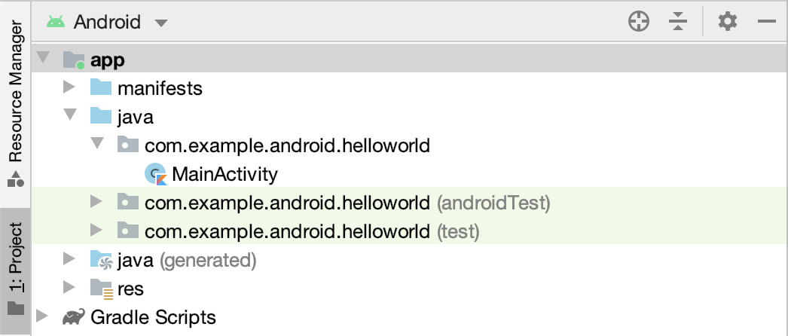
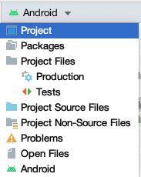
Examinar archivos en Android Studio
Notes:
Using Android Studio’s Project window, you can browse project files for your app. The Android view, which shows by default (image on the left), is structured for easy access to the files you need for app development. However, the Android view doesn’t reflect the actual file structure of your app (what you would see using the file explorer on your computer). To see how the folders and files actually look on your computer, switch to the Project view in the drop down menu (shown on the right). Feel free to use whichever view you prefer.
Resource:
Project Files

Slide 17
Diseños y recursos en Android

Slide 18
Views
Las vistas son los componentes básicos de la interfaz de usuario en Android
Delimitado por un área rectangular en la pantalla
Responsable del dibujo y manejo de eventos.
Ejemplos: TextView, ImageView, Button
Puede agruparse para formar interfaces de usuario más complejas
Notes:
Android comes with a large set of built-in classes for views (sometimes called widgets). For example, TextView, ImageView, and Button are commonly used views. Each View has different attributes depending on the type of View it is. Example attributes include width, height, whether it is visible, and more. For a TextView, example attributes include font size, font family, and the text to display.
Resources:
TextView
ImageView
Button

Slide 19
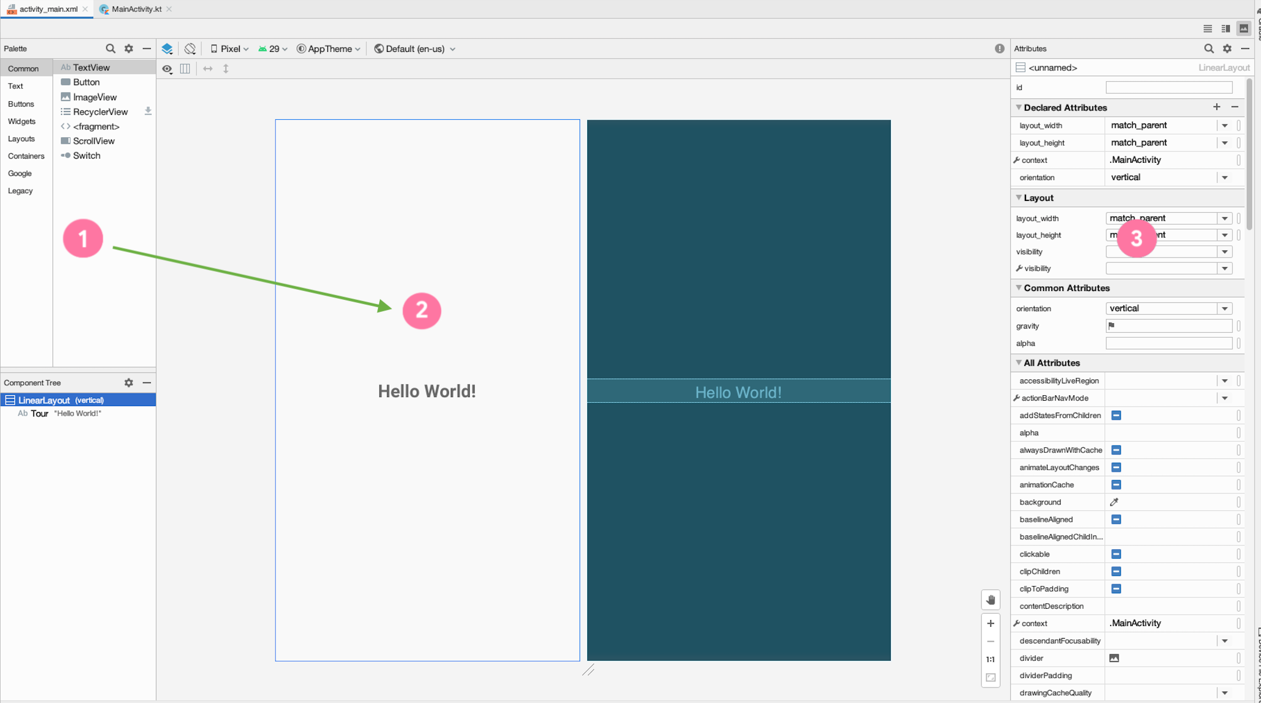
Editor de diseño
Notes:
In Android Studio, build your layout with the Layout Editor.
Drag and drop components from the Palette (1) into the Design view (2).
See a preview of your layout in the Design view (2).
Modify the attributes of the views on the right hand side in the Attributes window (3).
Resource:
Build a UI with Layout Editor

Slide 20
XML Layouts
También puede editar su diseño en XML.
Android usa XML para especificar el diseño de las interfaces de usuario (incluidos los atributos de vista)
Cada vista en XML corresponde a una clase en Kotlin que controla cómo funciona esa vista

Slide 21
XML para un TextView
<TextView
android:layout_width="wrap_content"
android:layout_height="wrap_content"
android:text="Hello World!"/>
Hello World!
Notes:
Here’s the XML for displaying a TextView in the layout. We see three attributes on the TextView: width, height, and text. These attributes are provided by either the base View class (width and height) or by the specific TextView class.

Slide 22
Tamaño para un View
wrap_content
android:layout_width="wrap_content"
match_parent
android:layout_width="match_parent"
Fixed value (use dp units)
android:layout_width="48dp"
Notes:
Android has several ways to specify the width and height of a View. These examples are for the layout_width of a View, but the same applies for the layout_height attribute of a View.
Use wrap_content to use only as much space as needed to display the content within the View. For example, if you want the View to be as wide as the text within the TextView, use wrap_content.
Use match_parent to use the dimension of the parent (such as matching the width of the parent View). For example, if you want the ImageView to take up the full size of the parent, set match_parent for its width and height.
Lastly, if you want a fixed size for the View, then set a specific dp (density-independent pixels) value. We will be revisiting the concept of dps in the next lesson when we learn more about layouts.

Slide 23
ViewGroups
Un ViewGroup es un contenedor que determina cómo se muestran las vistas.
FrameLayout
LinearLayout
ConstraintLayout
TextView
TextView
TextView
TextView
TextView
Button
Button
ViewGroup es el padre y las vistas dentro de él son sus hijos.
Notes:
To show more than one view on screen, use a ViewGroup. A ViewGroup is a container for views, and controls how views are organized and laid out on screen. This slide shows examples of three different ViewGroups.
Use a FrameLayout if you have only one child View.
Use a LinearLayout to display views in a row or column.
Use a ConstraintLayout for more complex layouts.
In general, choose the ViewGroup that meets your needs without being overly complex. For example, if you can get the job done with a LinearLayout, then there is no need to use a ConstraintLayout.
Let’s look at the XML for some of these ViewGroups.

Slide 24
FrameLayout ejemplo
Un FrameLayout generalmente contiene una sola vista secundaria.
<FrameLayout
android:layout_width="match_parent"
android:layout_height="match_parent">
<TextView
android:layout_width="match_parent"
android:layout_height="match_parent"
android:text="Hello World!"/>
</FrameLayout>
TextView
Notes:
In this example, the FrameLayout holds a single TextView. Note that the closing tag of the FrameLayout comes after the child TextView.
You can think of FrameLayout as a picture frame. It’s only meant to show one thing, so use it to hold a single child View. If you add more than one child within it, the views would overlap, which may be the desired behavior in some cases.

Slide 25
LinearLayout ejemplo
Alinea las vistas secundarias en una fila o columna
Set android:orientation to horizontal or vertical
<LinearLayout
android:layout_width="match_parent"
android:layout_height="match_parent"
android:orientation="vertical">
<TextView ... />
<TextView ... />
<Button ... />
</LinearLayout>
TextView
TextView
Button
Notes:
Here’s an XML example for the LinearLayout ViewGroup. LinearLayout is the parent for the three child views (two TextViews and a Button).
A LinearLayout lays out child views in a row or column. The layout direction is determined by the orientation attribute on the LinearLayout. In this case, the LinearLayout has a “vertical” orientation, so the layout will look like this diagram. Change the orientation to “horizontal” to have the views grouped in a horizontal row.

Slide 26
Jerarquia View
ImageView
LinearLayout
TextView
ImageView
TextView
LinearLayout
Button
Button
Button
Button
Notes:
We’ve talked about how views can have parent - child relationships if they’re placed within a ViewGroup. ViewGroups can also contain other ViewGroups. This creates a hierarchy of views that represent the layout of what’s displayed on the screen (on the right).

Slide 27
Recursos de la App
Contenido estático o archivos adicionales que usa su código
Layout files
Images
Audio files
User interface strings
App icon
Notes:
In addition to defining your own layouts, you can also add your own images, audio files, strings, app icon, and other resources to the app. Android provides a robust system to access them from anywhere in your app.

Slide 28
Directorios de recursos comunes
Agregue recursos a su aplicación incluyéndolos en el directorio de recursos apropiado en la carpeta res principal.
main
├── java
└── res
├── drawable
├── layout
├── mipmap
└── values
Notes:
The drawable directory stores all files related to drawing images and related assets.
The layout directory contains all the layout XML files for your application. There may be more than one if your app needs to handle different orientations or densities.
The mipmap directory contains files for your app icon (known as your launcher icon) at different screen densities.
The values directory contains files related to simple collections of strings, colors, integers, and styles. If you are localizing your app, you might have more than one values directory.
There are more subdirectories that may appear in the resources directory, but these are the ones that will be present in almost every Android project.

Slide 29
IDs de recursos
Cada recurso tiene un ID de recurso para acceder a él.
Al nombrar recursos, la convención es usar minúsculas con guiones bajos (por ejemplo, activity_main.xml).
Android genera automáticamente un archivo de clase llamado R.java con referencias a todos los recursos de la aplicación.
Los elementos individuales se referencian con : R.<resource_type>.<resource_name>
Ejemplos:
R.drawable.ic_launcher (res/drawable/ic_launcher.xml)
R.layout.activity_main (res/layout/activity_main.xml)

Slide 30
ID de recursos para vistas
Las vistas individuales también pueden tener ID de recursos.
Agregue el atributo android: id a la Vista en XML. Use la sintaxis @ + id / name.
<TextView
android:id="@+id/helloTextView"
android:layout_width="wrap_content"
android:layout_height="wrap_content"
android:text="Hello World!"/>
Dentro de su aplicación, ahora puede referirse a este TextView específico usando :
R.id.helloTextView
Notes:
If you assign IDs to the views in your layout, you can access them using R.id.<resource_name>. For example, this TextView has the resource ID name “helloTextView” and you can refer to it in your app using R.id.helloTextView. Be sure to use unique resource names so it is clear which element you want to refer to.

Slide 31
Actividades

Slide 32
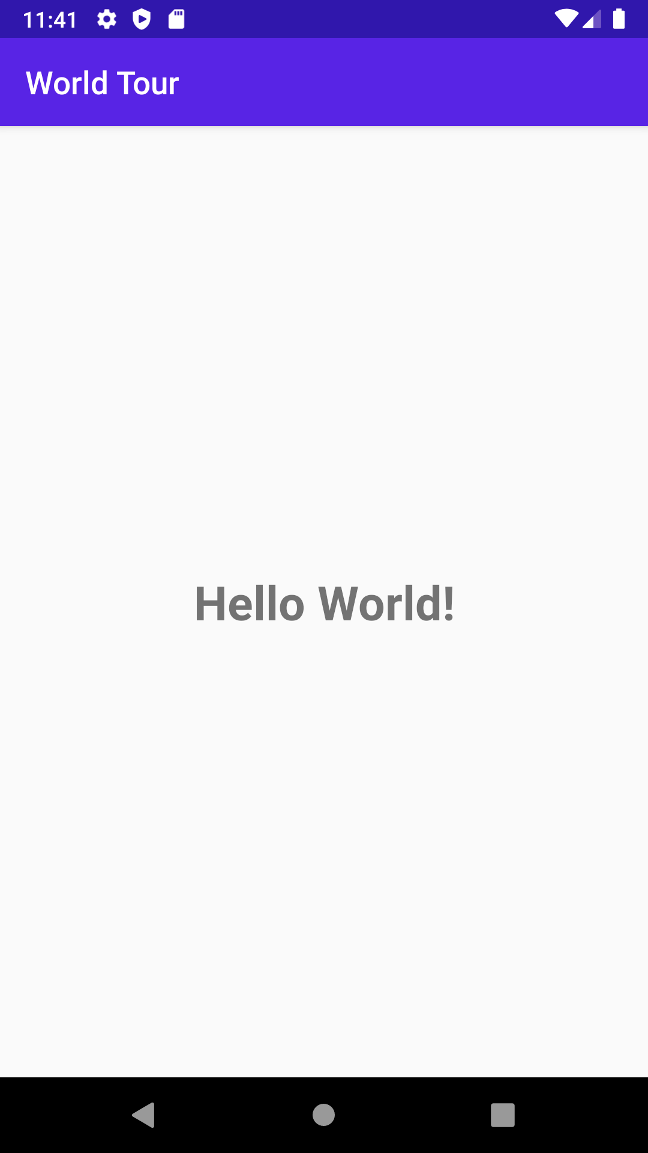
Que es una Actividad?
Una actividad es un medio para que el usuario logre un objetivo principal.
Una aplicación de Android se compone de una o más actividades.
Notes:
Examples of activities:
Displaying a list of emails
Displaying details of one specific item
Taking a photo using the camera

Slide 33
MainActivity.kt
class MainActivity : AppCompatActivity() {
override fun onCreate(savedInstanceState: Bundle?) {
super.onCreate(savedInstanceState)
setContentView(R.layout.activity_main)
}
}
Notes:
Let’s look at the code in MainActivity.kt. This was automatically generated because we selected the Empty Activity template in the new project wizard. Notice that it says “class” MainActivity.
It extends from the AppCompatActivity class, where we inherit behavior from the Android framework about how an Activity works. AppCompat for app compatibility ensures that newer features are available to legacy versions of Android.
Within the class, we have one function that is overriding the onCreate function that was defined in the superclass.

Slide 34
Cómo se ejecuta una actividad
Activity launched
onCreate()
App is running
Activity shut down
Notes:
Instead of launching a program through the main() function, as shown in earlier lessons, Android starts your app through an Activity instance.
Once the user taps your app icon on the device, Android opens your app by launching the main Activity of your app. Specifically, the onCreate() method is called when your Activity is created. The onCreate() method is just one of the Activity callback methods that is invoked from the system at certain stages of the Activity lifecycle. We’ll talk more about the lifecycle in a future lesson. For now, know that your Activity continues to run until the user or system takes action to shut it down.
Resource:
Introduction to Activities

Slide 35
Implementación de onCreate() callback
Llamado cuando el sistema crea su actividad
override fun onCreate(savedInstanceState: Bundle?) {
super.onCreate(savedInstanceState)
setContentView(R.layout.activity_main)
}
Notes:
Here’s what the onCreate() method looks like in the MainActivity.kt file of our sample app. In this callback method, we call into the superclass onCreate() method to set up the Activity. The Android framework handles a lot of this complexity for us. Then we call setContentView() so that the layout defined in the activity_main.xml file is displayed in the Activity. Let’s look at what happens when we call setContentView with a layout resource ID.
Resource:
onCreate()

Slide 36
Layout inflation
Activity
ViewGroup
Layout files
LayoutInflater
View1
layout1
layout2
layout3
ViewGroup
View2
View3
Notes:
The layout XML file is parsed by a LayoutInflater and a hierarchy of View objects is created to be displayed in the Activity. This process is called layout inflation.
Resource:
setContentView

Slide 37
Haz que una aplicación sea interactiva
Notes:
So far, we’ve talked about what goes into displaying a layout in your app. But eventually you'll want an app that can respond to user input, and provide different behavior accordingly.

Slide 38
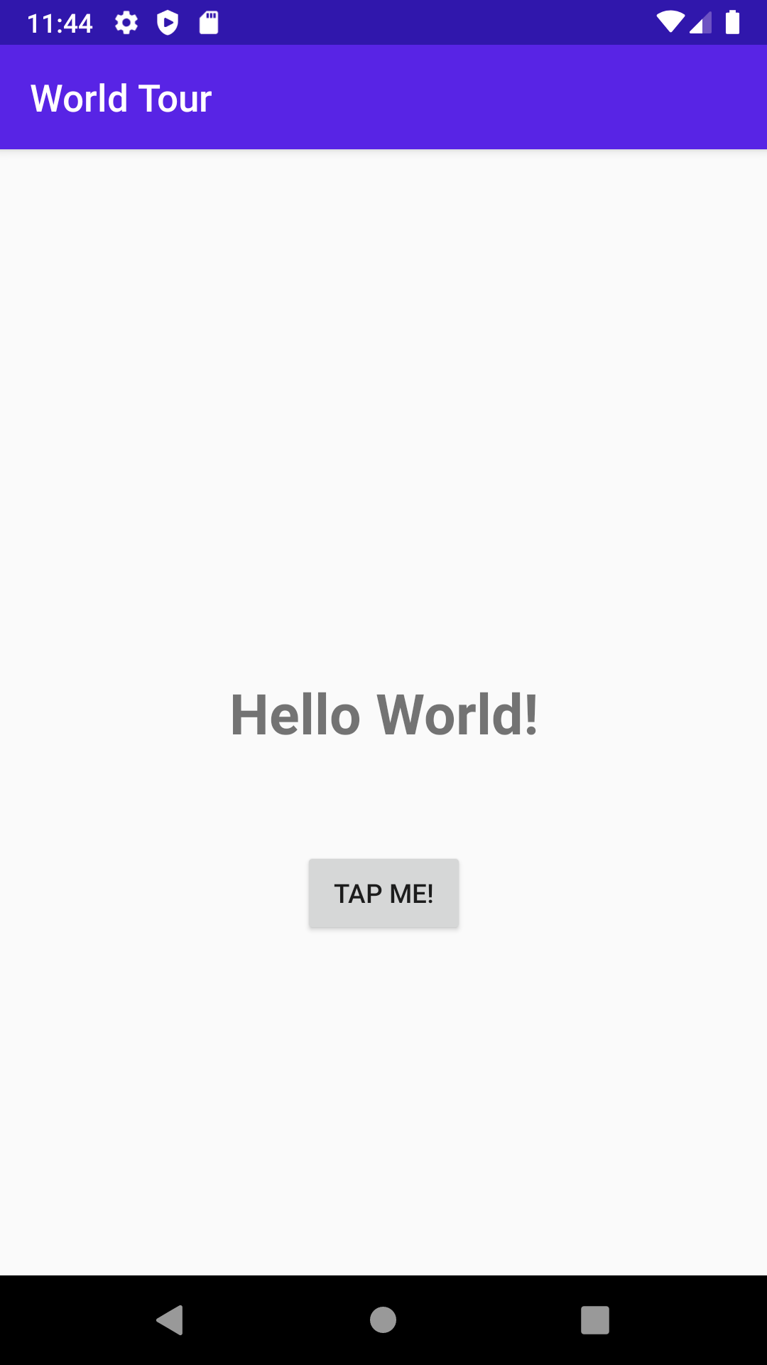
Comportamiento de la app en Actividad
Modifique la actividad para que la aplicación responda a la entrada del usuario, como el toque de un botón.
Notes:
You can define how your app will behave in the Activity file of your app. For example, you can modify the MainActivity so that the "Hello World" is displayed when the button is tapped.

Slide 39
Modificar una vista dinámicamente
Sin MainActivity.kt:
Obtener una referencia a la vista en la jerarquía de vistas :
val resultTextView: TextView = findViewById(R.id.textView)
Cambiar propiedades o llamar a métodos en la instancia de View :
resultTextView.text = "Goodbye!"
Notes:
Within the MainActivity, you can also dynamically modify the views in your layout. For example, you can get a reference to the TextView object instance in your View hierarchy using the findViewById() method, and passing in the resource ID for that TextView. Then you can change properties or call methods on the TextView. For example, setting resultTextView.text equal to the “Goodbye!” string changes what gets displayed in the TextView.

Slide 40
Configurar listeners para eventos específicos
User interacts with a View
An event is fired
Did developer register a callback?
No
Yes
Ignore the event
Execute the callback
Notes:
You can also set up listeners for certain things to happen based on user input. The base View class has a set of events that you can register callbacks to respond to. View.OnClickListener is the one you’ll interact with the most.
Resource:
View.OnClickListener

Slide 41
View.OnClickListener
class MainActivity : AppCompatActivity(), View.OnClickListener {
override fun onCreate(savedInstanceState: Bundle?) {
...
val button: Button = findViewById(R.id.button)
button.setOnClickListener(this)
}
override fun onClick(v: View?) {
TODO("not implemented")
}
}
Notes:
Let’s look at the code for how to set an OnClickListener on a View.
First we need to create the OnClickListener. In this case, we have the MainActivity implement the OnClickListener interface, and override the onClick() method.
Then we set the click listener (this) on the Button when the Activity is created.
Note that the onClick() method takes the View as a parameter allowing you to use the same onClick() function with different views.
Resources:
View.OnClickListener

Slide 42
SAM (single abstract method)
Convierte una función en una implementación de una interfaz
Format: InterfaceName { lambda body }
val runnable = Runnable { println("Hi there") }
is equivalent to
val runnable = (object: Runnable {
override fun run() {
println("Hi there")
}
})
Notes:
Transition: 1 click
Another way to define an OnClickListener is creating a class that implements the interface. Since the interface for View.OnClickListener has a single Single Abstract Method (SAM), Kotlin function literals can be automatically converted into an implementation of this interface. (The parameter types of the interface method must match the parameter types of the Kotlin function.)
Resource:
SAM Conversions

Slide 43
View.OnClickListener as a SAM
Una forma más concisa de declarar un listener de clicks
class MainActivity : AppCompatActivity() {
override fun onCreate(savedInstanceState: Bundle?) {
...
val button: Button = findViewById(R.id.button)
button.setOnClickListener({ view -> /* do something*/ })
}
}

Slide 44
Inicialización tardía
class Student(val id: String) {
lateinit var records: HashSet<Any>
init {
// retrieve records given an id
}
}
Notes:
Let’s talk about one more Kotlin concept that we can leverage.
In the last lesson, we learned that Kotlin has a strong preference for null safety. As you're creating apps, you’ll find yourself needing to create properties or fields that may depend on function calls such as onCreate. One option is to make the type nullable and set the initial value to null. That means each use would need to have a null check. You can avoid having to do this by using lateinit, which just tells the Kotlin compiler that you're responsible for the initialization. If you attempt to use your lateinit field or property before initializing, an exception will be thrown.
Resource:
lateinit

Slide 45
Lateinit ejemplo sobre una actividad
class MainActivity : AppCompatActivity() {
lateinit var result: TextView
override fun onCreate(savedInstanceState: Bundle?) {
...
result = findViewById(R.id.result_text_view)
}
}
Notes:
In our MainActivity class, we can’t initialize the result TextView until the layout has been inflated. So wait until the onCreate() method to get a reference to the TextView in the layout to initialize the result TextView. Then you are free to use the result property and be certain that it won’t be null. If you use the property before it’s initialized, an exception is thrown.

Slide 46
Gradle: Construyendo un
aplicación Android
Notes:
Let’s move onto the last section of our lesson today. If you remember, the anatomy of a basic app includes an Activity, resources and layouts, and Gradle files. Let’s discuss Gradle.
Building an app is complex, and there are specific tasks that have a sequence they must run in. Android uses Gradle to manage these tasks and build your app.

Slide 47
Que es Gradle?
Construye un sistema de automatización
Gestiona el ciclo de compilación a través de una serie de tareas (por ejemplo, compila las fuentes de Kotlin, ejecuta pruebas, instala la aplicación en el dispositivo)
Determina el orden correcto de ejecución de las tareas.
Gestiona las dependencias entre proyectos y bibliotecas de terceros.
Notes:
Gradle uses a directed acyclic graph to determine which tasks are required for the intended tasks, what order to run them in, and then runs them.

Slide 48
Archivo de compilación de Gradle
Declarar complementos
Definir propiedades de Android
Manejar dependencias
Conectarse a repositorios
Notes:
It appears like a simple text file, but it's more than that. It’s code with a bit of (Groovy) magic. Let’s look at parts of the Gradle build file.

Slide 49
Plugins
Proporcione las bibliotecas y la infraestructura que necesita su aplicación
apply plugin: 'com.android.application'
apply plugin: 'kotlin-android'
apply plugin: 'kotlin-android-extensions'
Notes:
A build.gradle file will usually include a plugin section where the build script declares which plugins will be applied. Plugins provide additional functionality as supplementary tasks and dependencies freeing you as a developer from having to declare all the dependencies.

Slide 50
Configuración Android
android {
compileSdkVersion 30
buildToolsVersion "30.0.2"
defaultConfig {
applicationId "com.example.sample"
minSdkVersion 19
targetSdkVersion 30
}
}
Notes:
In the Android configuration block, you set the specifics of what makes your app run on Android, such as SDK versions, test runners, build targets, and so forth.

Slide 51
Dependencias
dependencies {
implementation "org.jetbrains.kotlin:kotlin-stdlib-jdk7:$kotlin_version"
implementation 'androidx.core:core-ktx:1.3.2'
implementation 'androidx.appcompat:appcompat:1.2.0'
implementation 'com.google.android.material:material:1.2.1'
...
}
Notes:
When you create an Android app, you aren’t expected to create everything from scratch. The dependencies block lets you refer to libraries you want to use, either locally or remote, in a standardized way to make sure they have any sub-dependencies they need, and don’t conflict with one another. This is another reason it’s important to organize your code in packages.

Slide 52
Respositorios
repositories {
google()
mavenCentral()
}
Notes:
Out on the web, there are collections of libraries organized in repositories. Use the repositories block to specify where to look for them. Gradle will start at the first listed repository and fall through to each subsequent one if it doesn’t find the resource.

Slide 53
Tareas comunes de Gradle
Clean
Tasks
InstallDebug
Notes:
The clean task deletes all compiled files from the build directory.
Tasks outputs a list of tasks for your project and any installed plugins.
InstallDebug compiles the app if necessary, builds a debug APK, and installs it on a connected physical or emulated device.
You typically won’t need to run Gradle from the command line; you should be able to run any needed tasks directly from Android Studio.

Slide 54
Accesibilidad
Notes:
Before we wrap up this lesson, let’s discuss another important topic to keep in mind as you build Android apps.
Android apps should aim to be usable by everyone, including people with accessibility needs.

Slide 55
Accesibilidad
Se refiere a mejorar el diseño y la funcionalidad de su aplicación para que sea más fácil de usar para más personas, incluidas aquellas con discapacidades.
Hacer que su aplicación sea más accesible conduce a una mejor experiencia de usuario en general y beneficia a todos sus usuarios
Notes:
Note: You may see accessibility abbreviated as "a11y".

Slide 56
Haz que las aplicaciones sean más accesibles
Aumente la visibilidad del texto con la relación de contraste de color de primer plano y de fondo :
Por lo menos 4.5:1 para texto pequeño contra el fondo
Por lo menos 3.0:1 para texto grande contra el fondo
Use controles grandes y simples
El tamaño del objetivo táctil debe ser al menos 48dp x 48dp
Describe cada elemento de la interfaz de usuario
Establecer la descripción del contenido en imágenes y controles
Notes:
Here are some tips on how to make your app more accessible.
Resources:
Make apps more accessible
Color contrast
Label elements

Slide 57
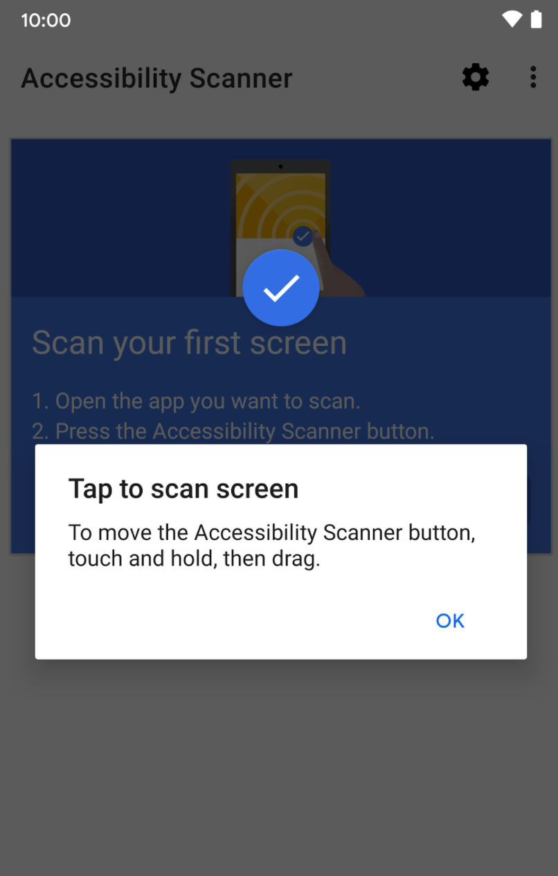
Escáner de accesibilidad
Herramienta que escanea su pantalla y sugiere mejoras para hacer su aplicación más accesible, basada en :
Content labels
Touch target sizes
Clickable views
Text and image contrast
Notes:
The Accessibility Scanner is a useful tool to identify opportunities to improve your app in terms of accessibility.
Permissions Notice: Because this app is an accessibility service, it can observe your actions, retrieve window content, and observe text that you type.
If you are okay with these permissions, download the Accessibility Scanner app from Google Play and turn it on under the Settings > Accessibility menu. Then open the app you want to scan on your device, and follow the prompts to scan your app screen.
Resources:
Accessibility Scanner app on Google Play
Accessibility Scanner Support Guide

Slide 58
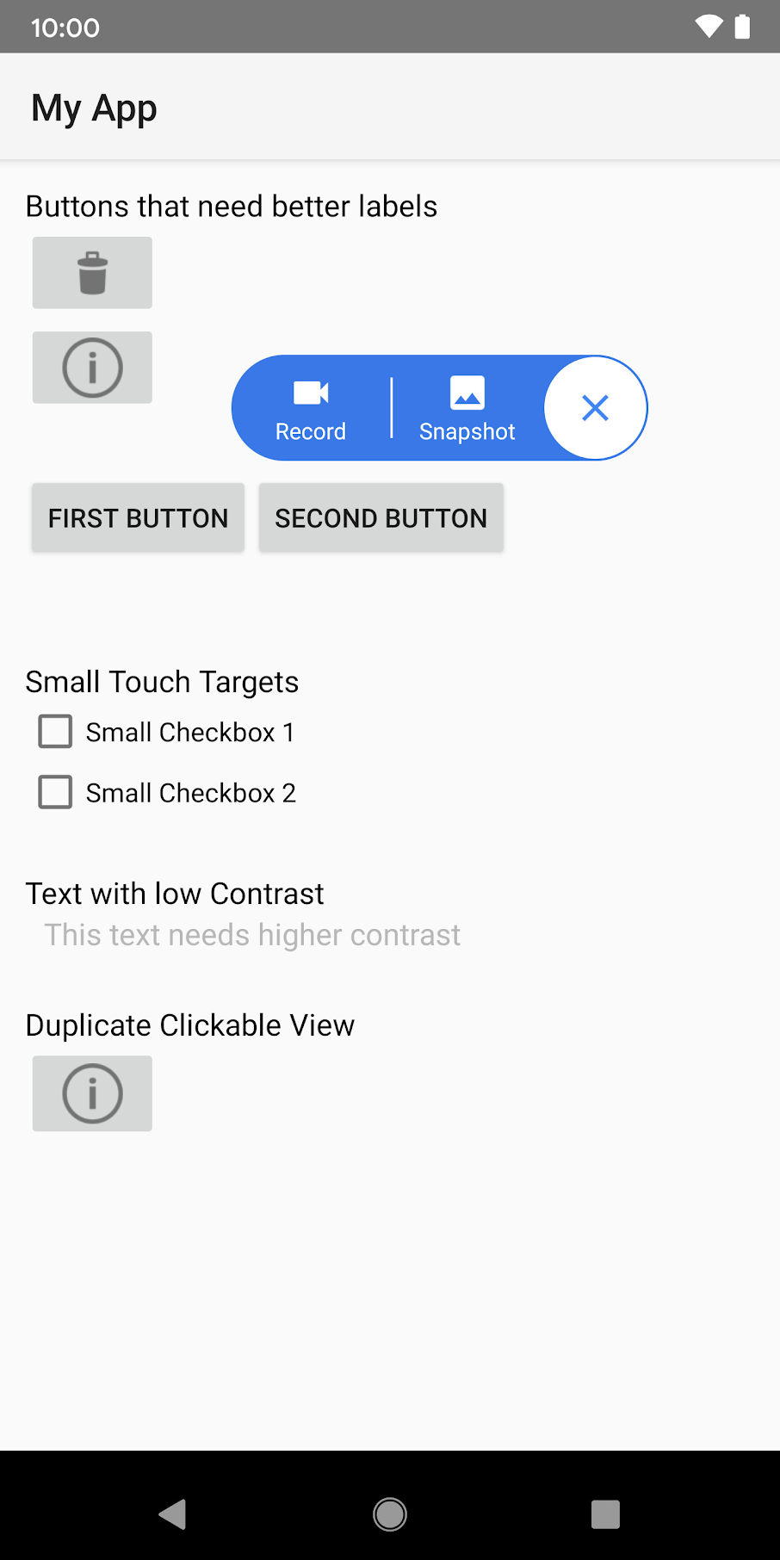
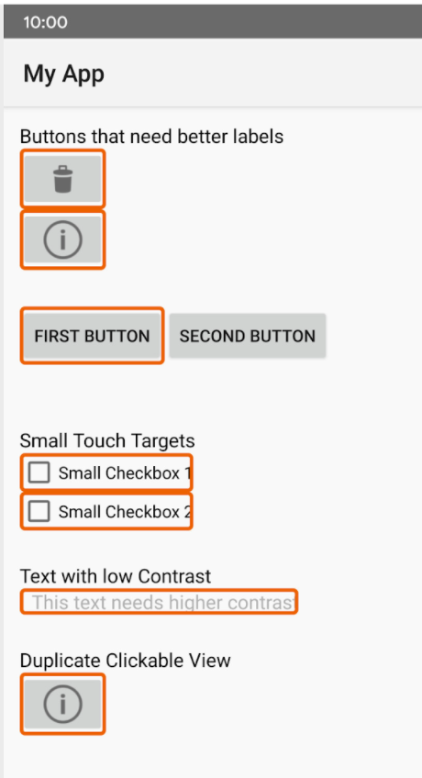
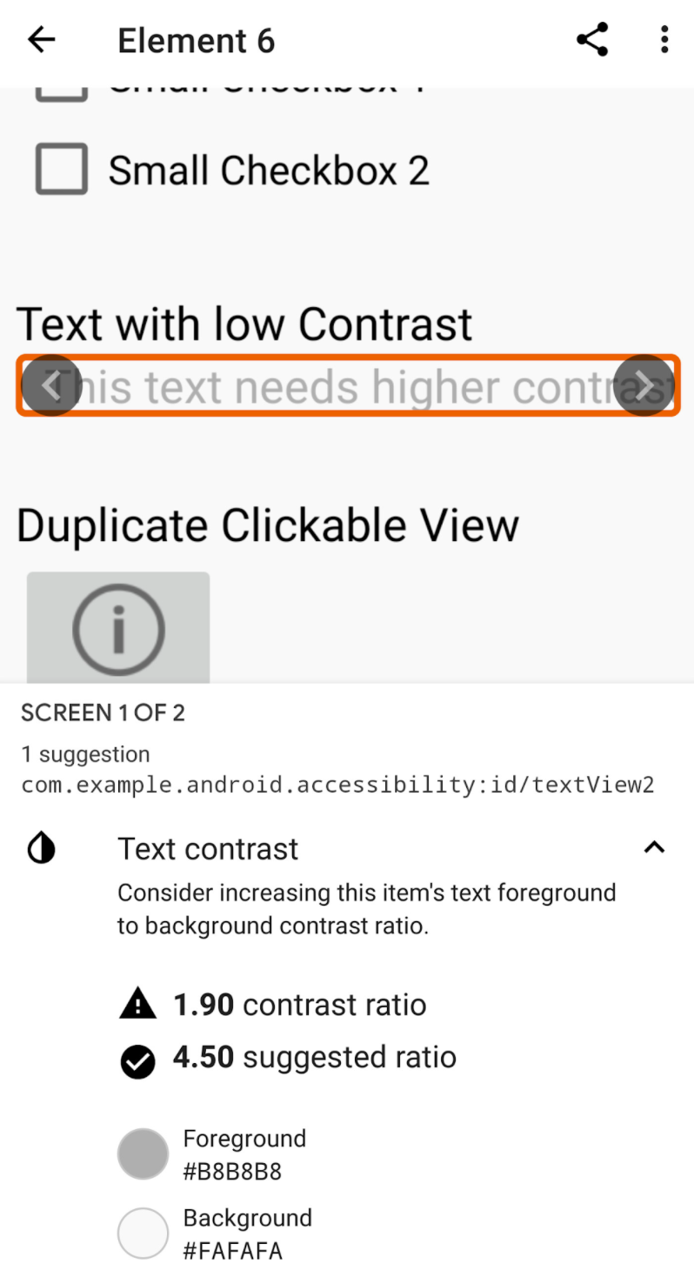
Ejemplo de escáner de accesibilidad
Notes:
In this example, the scanner has found buttons that need better labels, checkboxes that are too small to be easily touched, text with low contrast that is difficult to read, and a duplicate clickable view. Making these suggested improvements will improve the user experience for your app.
Note that this app may not catch all issues, so you should still verify with other means that your app adheres to accessibility guidelines.

Slide 59
Agregar etiquetas de contenido
Establecer el atributo contentDescription → leer en voz alta por el lector de pantalla
<ImageView
...
android:contentDescription="@string/stop_sign" />
El texto en TextView ya se proporciona a los servicios de accesibilidad, no se necesita una etiqueta adicional
Notes:
Other recommended best practices:
Don’t include the type of UI element (e.g., button) in the description because screen readers automatically announce the element type with the description.
Each description should be unique.
Resources:
Describe each UI element
Content labels

Slide 60
No se necesita etiqueta de contenido
Para elementos gráficos que son puramente decorativos, puede establecer
android:importantForAccessibility="no"
Eliminar anuncios innecesarios es mejor para el usuario
Notes:
If a graphical UI element doesn’t need a content description, you can set android:importantForAccessibility="no". This means that this view is not important for accessibility.
This prevents the screen reader from having to announce non-essential information, and makes it easier for users to access the more important information more quickly.
Resource:
android:importantForAccessibility attribute

Slide 61
TalkBack
Lector de pantalla de Google incluido en dispositivos Android
Proporciona comentarios hablados para que no tenga que mirar la pantalla para usar su dispositivo
Le permite navegar por el dispositivo mediante gestos.
Incluye teclado braille para Braille inglés unificado
Notes:
To test out that you have properly added descriptions to your app’s UI elements, use the TalkBack screen reader.
You can turn on Talkback by navigating to your device's Settings app > Accessibility. Or you can try the shortcut of pressing both volume keys for 3 seconds. If the shortcut doesn’t work, you may need to enable the shortcut in the settings menu first (see resource below).
Resources:
TalkBack screen reader
Volume key shortcut
Navigate your device with TalkBack
TalkBack gestures
TalkBack braille keyboard

Slide 62
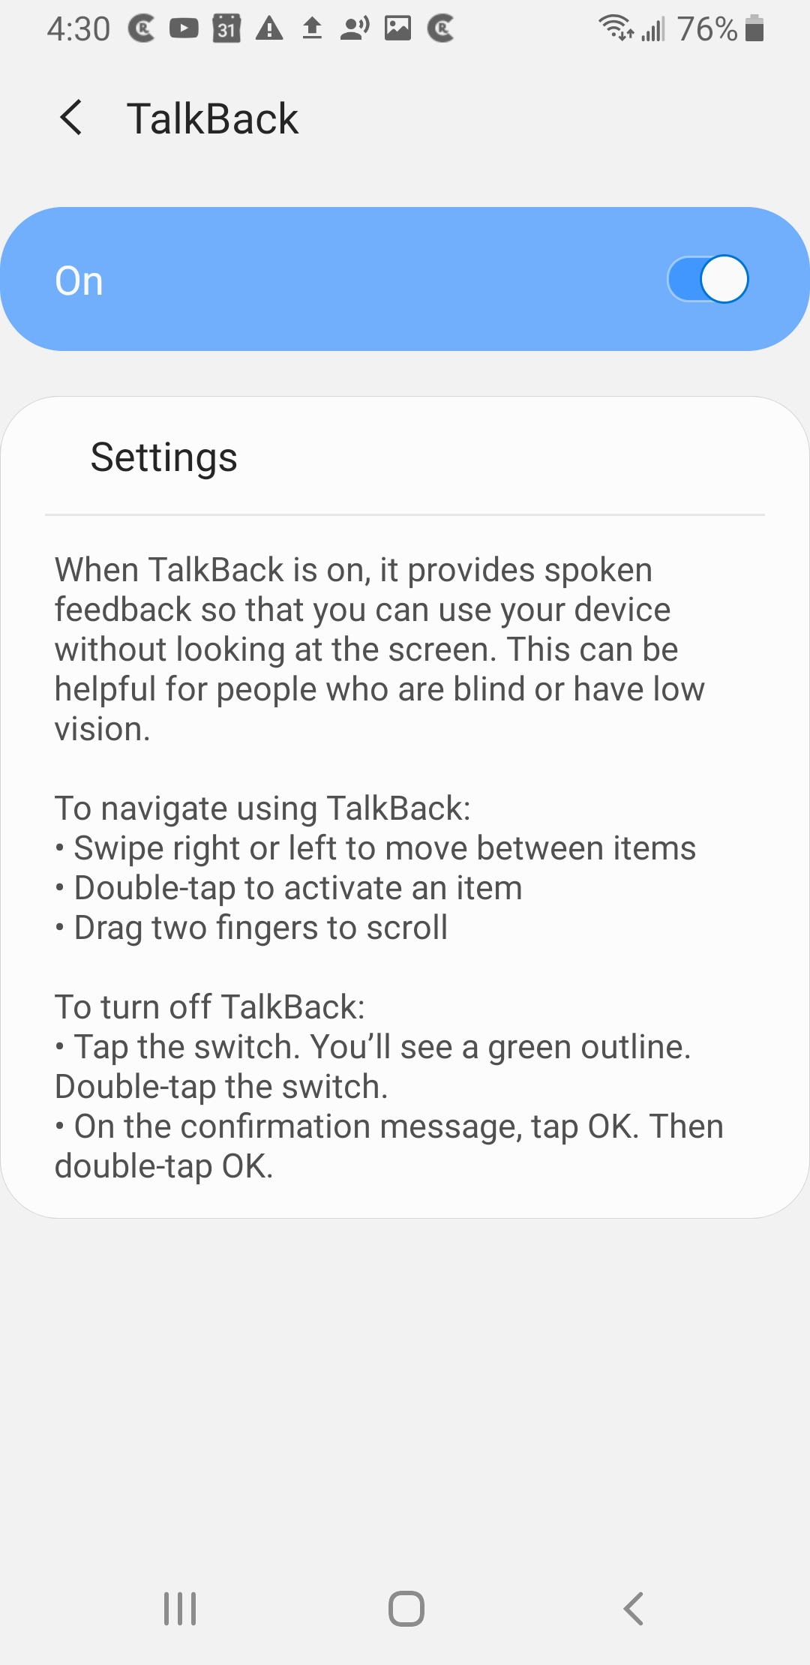
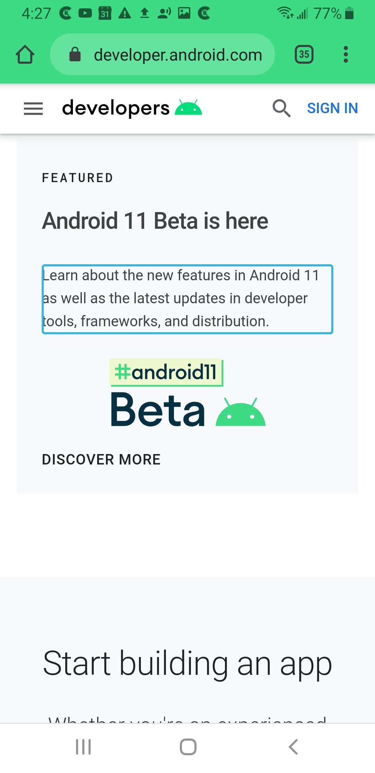
TalkBack ejemplo
Lee texto en voz alta mientras el usuario navega por la pantalla
Notes:
We recommend that you test your app with TalkBack turned on. For more details, see the resource below.
Resource:
Test your app’s accessibility with TalkBack

Slide 63
Cambiar acceso
Permite controlar el dispositivo usando uno o más interruptores en lugar de la pantalla táctil
Escanea la interfaz de usuario de su aplicación y resalta cada elemento hasta que realiza una selección
Úselo con un interruptor externo, un teclado externo o botones en el dispositivo Android (por ejemplo, botones de volumen)
Notes:
We also recommend that you test your app with Switch Access turned on. See the testing guide below for more details.
Resources:
Switch Access for Android
Testing your app with Switch Access on

Slide 64
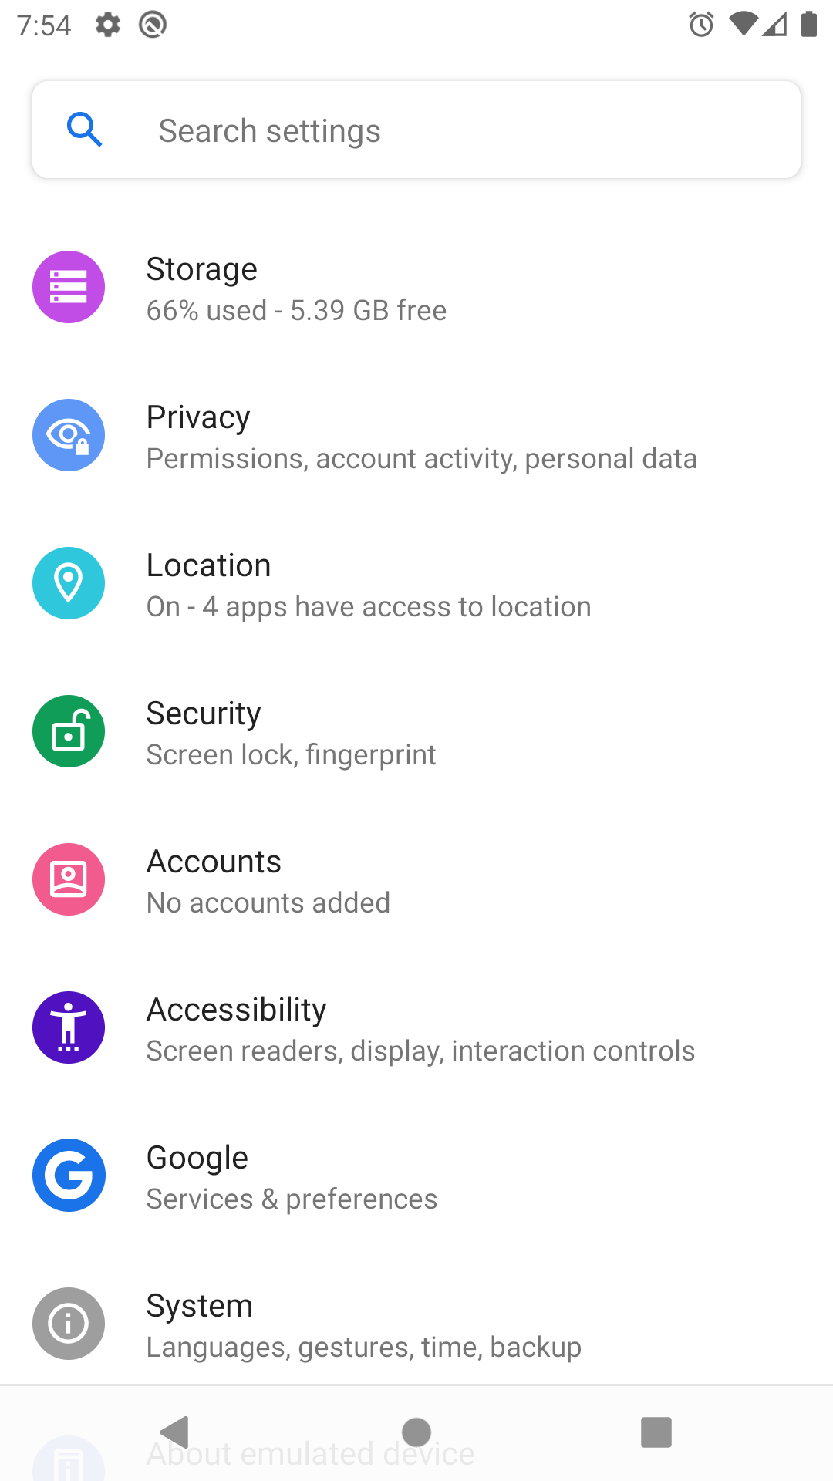
Suite de accesibilidad de Android
Colección de aplicaciones de accesibilidad que lo ayudan a usar su dispositivo Android sin ojos o con un dispositivo de conmutación. Incluye :
Talkback screen reader
Switch Access
Accessibility Menu
Select to Speak
Notes:
TalkBack and Switch Access are part of the Android Accessibility Suite, which are built into many Android devices. There’s also the Accessibility Menu (large on-screen menu to lock your phone, control volume and brightness, take screenshots, and more), and Select to Speak (select items on your screen and hear them read aloud).
Access these accessibility features via the device's Settings > Accessibility menu.
Resource:
Android Accessibility Suite

Slide 65
Recursos de accesibilidad
Cree aplicaciones más accesibles
Principios para mejorar la accesibilidad de las aplicaciones
Codelab básico de accesibilidad de Android
Mejores prácticas de Material Design sobre accesibilidad

Slide 66
Resumen

Slide 67
Resumen
Usted aprendio a:
Utilice vistas y grupos de vistas para crear la interfaz de usuario de su aplicación
Acceda a los recursos de su aplicación desde R.<resource_type>.<resource_name>
Definir el comportamiento de la aplicación en la actividad (por ejemplo, registrar OnClickListener)
Use Gradle como el sistema de compilación para crear su aplicación
Siga las mejores prácticas para hacer que sus aplicaciones sean más accesibles

Slide 68
Aprende más
Layouts
LinearLayout
Input events overview
View
ViewGroup

Slide 69

Ruta
Practica lo que has aprendido al
completar el itinerario :
Leccion 4: Crea tu primera aplicación

